Slide 1
Fast IIR Isotropic 2-D Complex Gabor
Filters with Boundary Initialization
Alexandre Bernardino & José Santos-Victor
IEEE Transactions on Image Processing,
Vol. 15, No. 11, pp. 3338–3348, Nov 2006
Date: Feb, 8th, 2007
Introducer: Hor, Chiou-yi

Slide 2
Introduction
A Gabor filter is an optimum choice that provides simultaneous time (or space) and frequency selectivity to examine local structures in signal (or image) processing.
Gabor filters have been used in many applications, such as texture segmentation, target detection, fractal dimension management, document analysis, edge detection, retina identification, image coding and image representation.
This paper proposes a fast and recursive algorithm to perform the isotropic complex Gabor filtering.

Slide 3
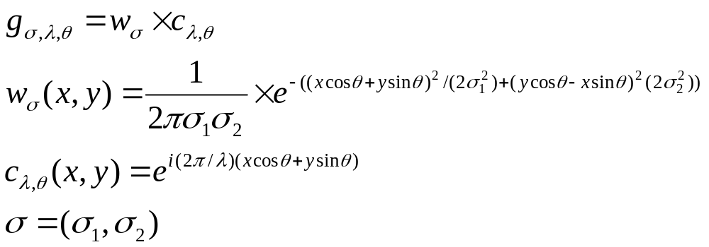
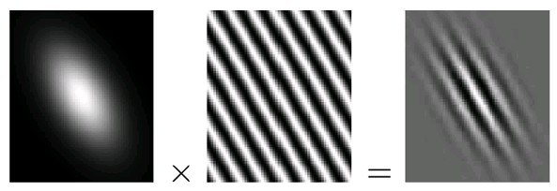
Nomenclature
Gabor filter
  A linear filter whose impulse response is defined by a harmonic function multiplied by a Gaussian function

Slide 4



Methodology
Gabor filtering
  Convolving an image f with a Gabor filter
Zero-Mean Gabor filter
  A Gabor filter with zero-mean correction
  Zero-Mean Gabor filtering

Slide 5
Nomenclature
FIR(finite impulse response) filter
  A filter which has fixed-duration impulse responses can be implemented by convolution
  Convolution example: y[n]=a0*x[n]+a1*x[n-1]+a2*x[n-2]+…
IIR(infinite impulse response) filter
  A filter whose impulse response is non-zero over an infinite length of time can be implemented by recursion
  Recursive filters are an efficient way of achieving a long impulse response, without having to perform a long convolution.
  Example: y[n]=a0*x[n]+a1*x[n-1]+a2*x[n-2]+…+b0*y[n]+b1*y[n-1]+b2*y[n-2]

Slide 6
Nomenclature
Phase response
  The relationship between the phase of a sinusoidal input and an output as signal passing through a filter.
  Zero and linear phase filters have left and right edges that look the same, while nonlinear phase filters have left and right edges that look different.
  It is easy to make an FIR filter have a linear phase but it is not the case for IIR filter.

Slide 7
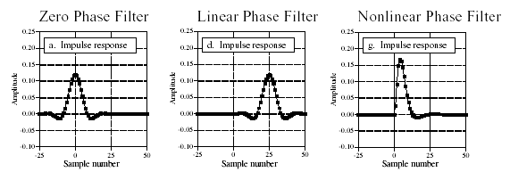
Nomenclature
Phase response (continued)

Slide 8
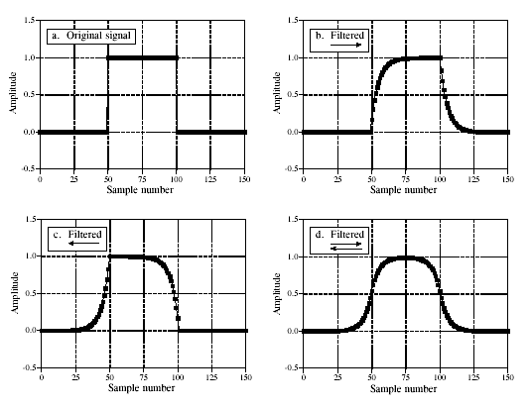
Nomenclature
Bidirectional recursive filtering
  A technique to make a recursive filter zero-phase

Slide 9
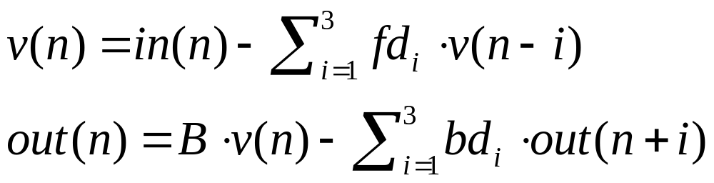




Nomenclature
Bidirectional recursive filtering (continued)
  The implementation is
  In classic Gabor filtering case, it is required to perform 98 operations for each pixel
    1 real addition
    6 complex multiplications (*6)
    5 complex additions (*2)
    1 multiplication between a real and a complex number (*2)
    2D case : (1*1+6*6+5*2+1*2)*2=98

Slide 10
Nomenclature
Bidirectional recursive filtering (continued)
  In classic zero-mean Gabor filtering case, it is required to perform 126 operations for each pixel
    Gabor filtering : 98
    1 real Gaussian filtering: 26
    1 real multiplication: 1
    1 real addition: 1
    Total: 126

Slide 11
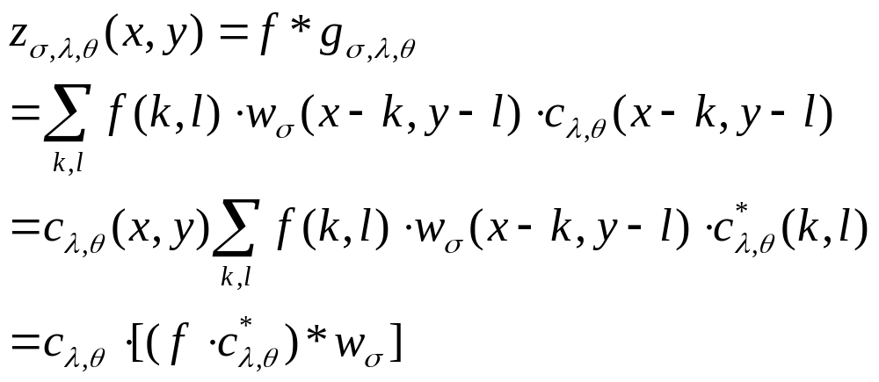
Methodology
Harmonic function separation
  Modulation (real-complex multiplication . ): 2
  Complex Gaussian filtering (complex convolution *): 52
  Demodulation (complex multiplication .): 6
  Total: 60

Slide 12
Methodology
Harmonic function separation with zero-mean correction
  Harmonic separation: 60
  1 real Gaussian filtering: 26
  1 real multiplication: 1
  1 real-complex addition: 1
  Total: 88

Slide 13
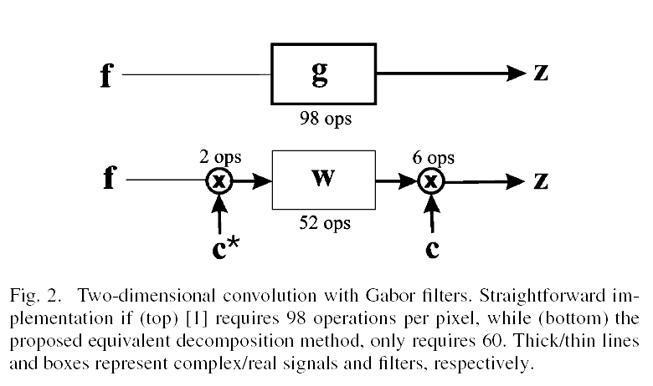
Comparison

Slide 14
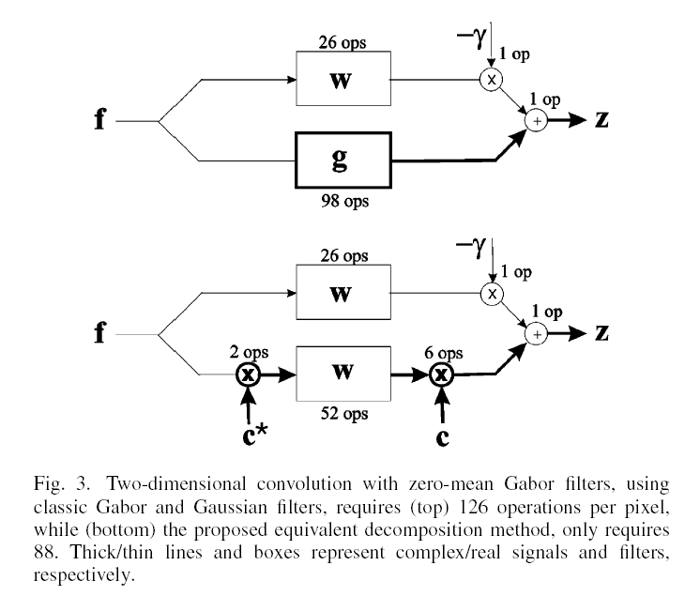
Comparison

Slide 15
Methodology
Boundary Initialization
  Without special initialization, filtering operations produce spurious transients at image boundaries
  For complete transient extinction, the boundary should be extended by more than three times the scale of the filter.
    This would imply a significant increase in computation time for a large scale filter .
  A better solution is to derive adequate values to initialize the filter state at the boundaries, thus avoiding explicit filtering at the extended boundaries.

Slide 16
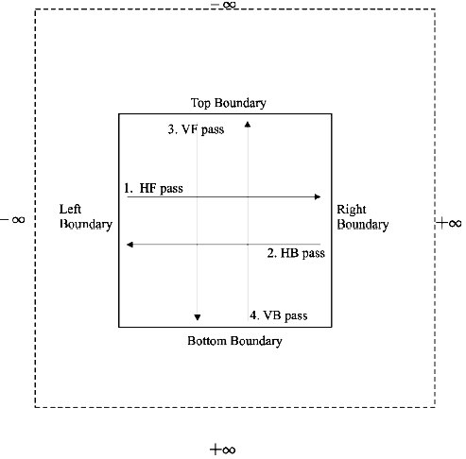
Methodology
Boundary Initialization (Continued)

Slide 17

Methodology
Boundary Initialization (Continued)
  The recursive filter
  For the above filter, only three additional boundary pixel is calculated

Slide 18
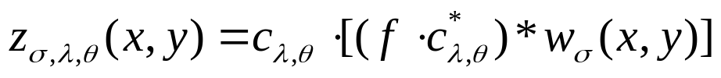

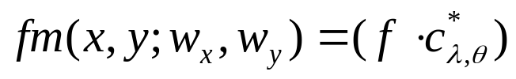
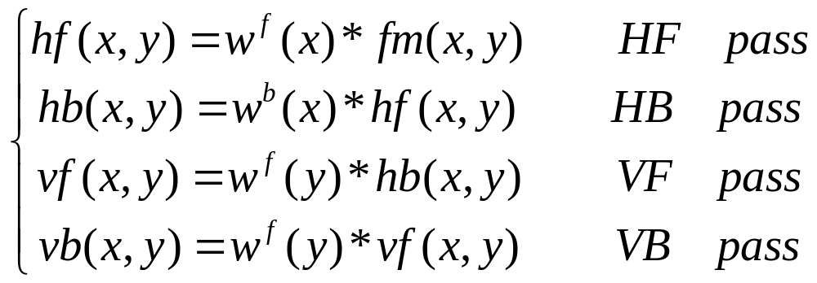
Methodology
Boundary Initialization (Continued)
  Gaussian filter separation
  Let
  Cascading filtering operation

Slide 19
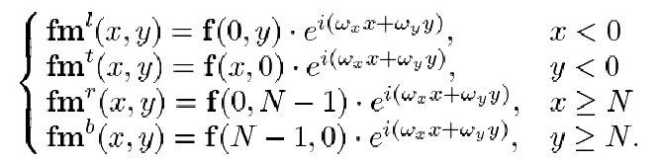
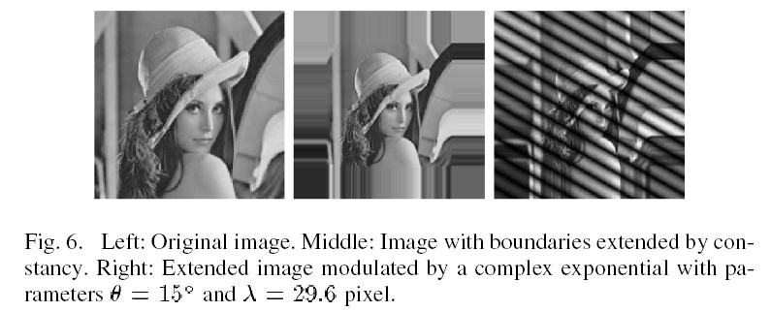
Methodology
Boundary Initialization (Continued)
  For first pass

Slide 20
Methodology
Boundary Initialization (Continued)
  For forward case, the overhead is: 3 real multiplications and 3 complex multiplications
  For backward case, the overhead is: 12 real multiplications and 3 complex additions
  The overall overhead is 201/N per pixel, N is the image’s width or height

Slide 21
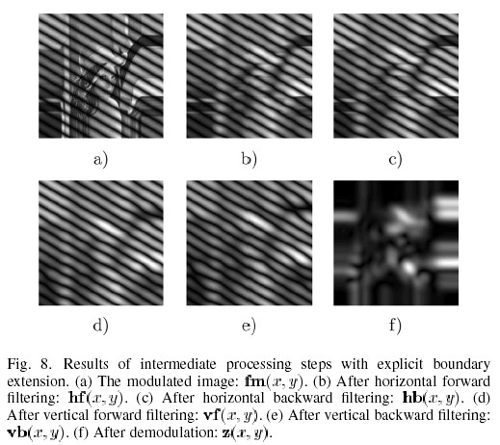
Results

Slide 22
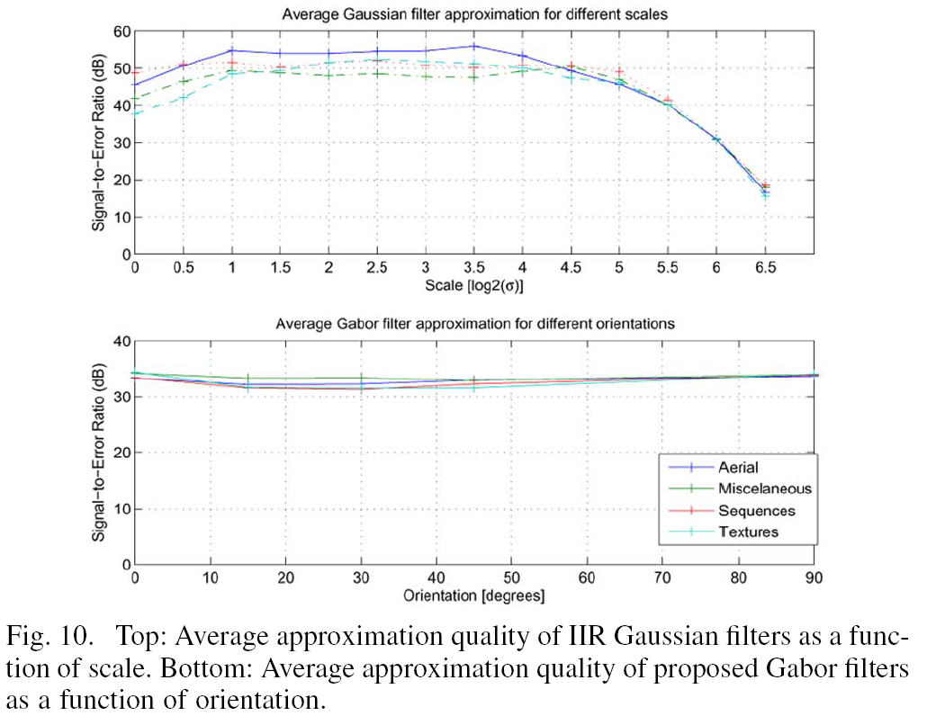
Results

